Slide 1

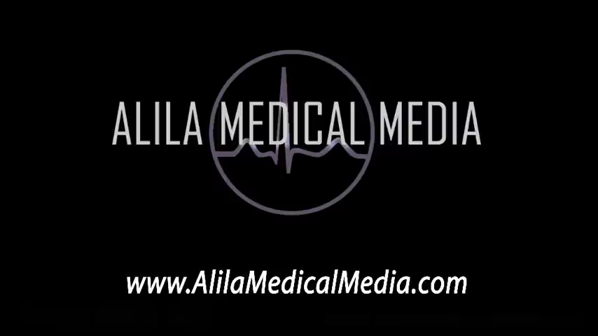
The Pathway of Blood Flow Through the Heart
https://www.youtube.com/watch?v=BEWjOCVEN7M

Slide 2
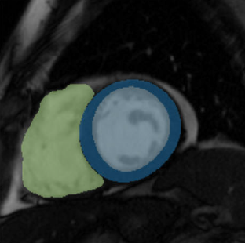
What is cardiac magnetic resonance (CMR)
a type of MRI specifically focused on the heart
uses magnetic fields and radio waves to create detailed images of the heart and surrounding blood vessels.
What are "Blood pool" and "myocardium“ regions:
The blood-pool region refers to the interior cavity of a ventricle (or atrium) where the blood is flowing.
The myocardium region is the muscular wall surrounding that cavity — the heart muscle itself
Myocardial blood flow (MFB) = how much blood actually reaches that muscle through the coronary arteries

Slide 3
The Pathway of Blood Flow Through the Heart, Animation.
What is Cardiac magnetic resonance (CMR)
A medical imaging test that uses a strong magnetic field and radio waves to create detailed and moving pictures of the heart and its blood vessels.
Advantages of CMR:
Widespread Availability,
High Temporal and Spatial Resolution,
No ionizing radiation.
Limitation:
Lack of dependable quantitative analysis (p1R1)

Slide 4
The problem to measure blood flow in heart and vessels
How to estimate blood flow in the heart muscle:
By injecting a material called gadolinium into the bloodstream, and then by taking a sequence of MRI images
What is the problem:
MRI signal is not directly proportional to gadolinium concentration
The MRI scanner measures signal intensity,
Not the actual concentration of gadolinium
The relationship between these two is not perfectly linear
This is a big problem for quantitative analysis
Solution:
Must use a robust mathematical models, like the Fermi function deconvolution

Slide 5
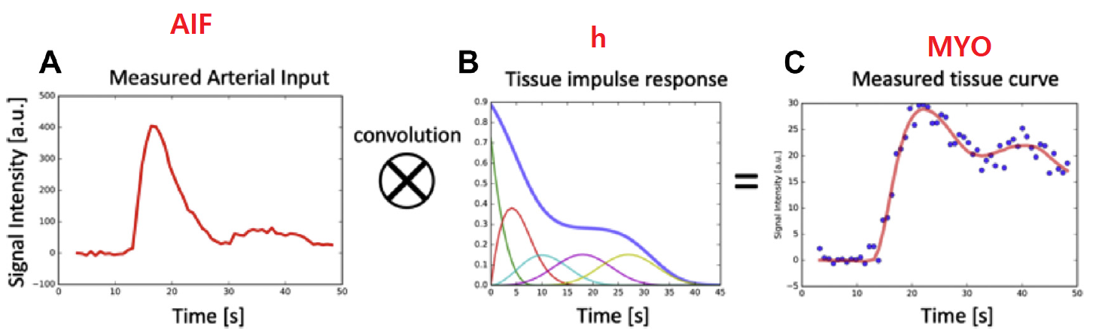
How myocardial blood flow (MBF) is calculated
Once the signal-intensity curves are corrected, a mathematical model could be used to compute MBF.
There are two main modeling approaches:
a) Tracer-kinetic (blood-tissue exchange) model
b) Deconvolution approach
It assumes that the tissue signal curve is the convolution of the input (AIF) with the tissue impulse response
By deconvolving the tissue curve with the AIF, we recover that impulse response.
The height (amplitude) of this impulse response at time zero represents the blood flow through that tissue.
Because deconvolution is a mathematically unstable (for example by using Fourier Transform negative values obtained) a constrain such as the Fermi function is used, which provides a smooth and physiologically realistic shape for the response curve.

Slide 6
The Pathway of Blood Flow Through the Heart, Animation.

Slide 7
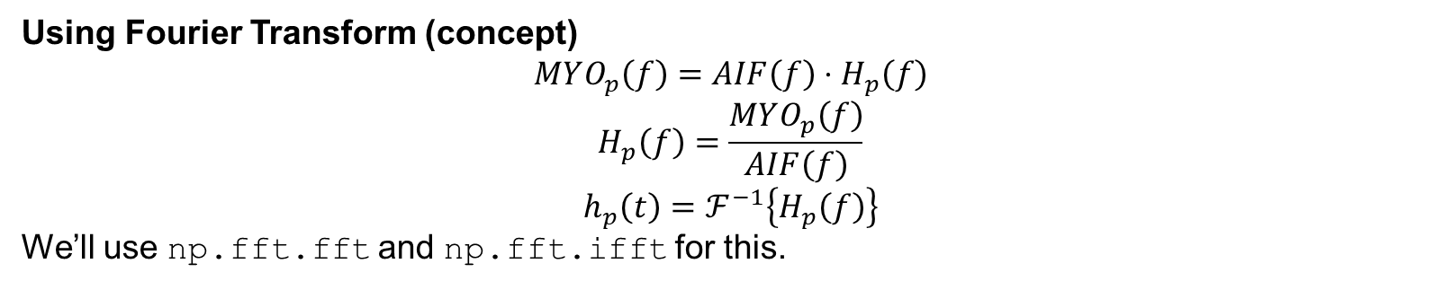
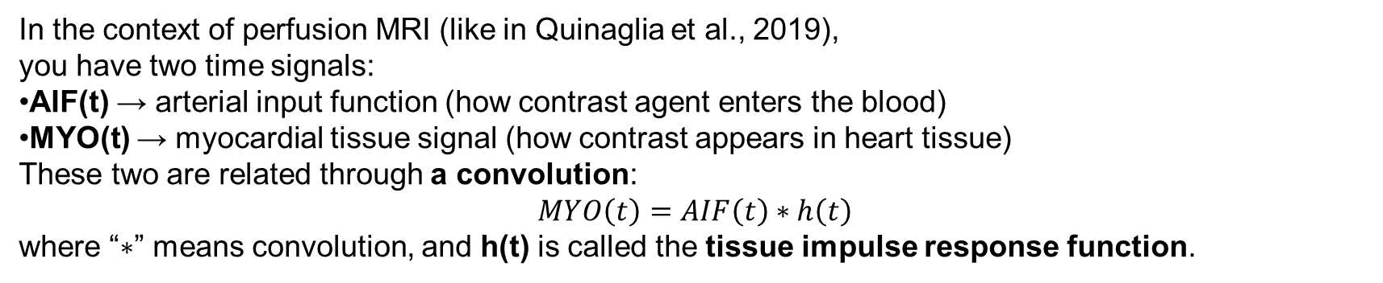
The Pathway of Blood Flow Through the Heart, Animation.
In the context of perfusion MRI (like in Quinaglia et al., 2019), you have two time signals:
AIF(t) → arterial input function (how contrast agent enters the blood)
MYO(t) → myocardial tissue signal (how contrast appears in heart tissue)
These two are related through a convolution:
$$MYO\left(t\right)=AIF\left(t\right)∗h\left(t\right)$$
where “$∗$” means convolution, and h(t) is called the tissue impulse response function.
To find $h\left(t\right)$, you need to undo the convolution, which is called deconvolution.
Using Fourier Transform (concept)
$$MYO_{p}\left(f\right)=AIF\left(f\right)⋅H_{p}\left(f\right)$$
$$H_{p}\left(f\right)=\frac{MYO_{p}\left(f\right)}{AIF\left(f\right)}$$
$$h_{p}\left(t\right)=ℱ^{−1}\left\{H_{p}\left(f\right)\right\}$$
We’ll use np.fft.fft and np.fft.ifft for this.

Slide 8
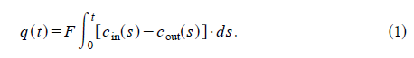
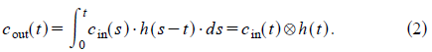
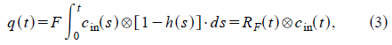
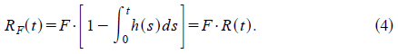
The Pathway of Blood Flow Through the Heart, Animation.
the amount of tracer in the ROI at any time, q(t), is simply the difference between the amount of tracer that was washed in and washed out.
F is the rate of flow
R(t) represents the probability that a tracer molecule remains in the ROI up to time t.
The shape of the tissue impulse response, R(t), can be approximated with a Fermi function.

Slide 9
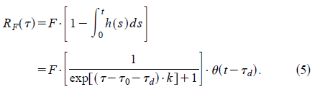
The Pathway of Blood Flow Through the Heart, Animation.
The analytical expression for the Fermi function model is:
u (t2t d), a unit step function, equals 0 for t<t_d and 1 for t>t_d

Slide 10
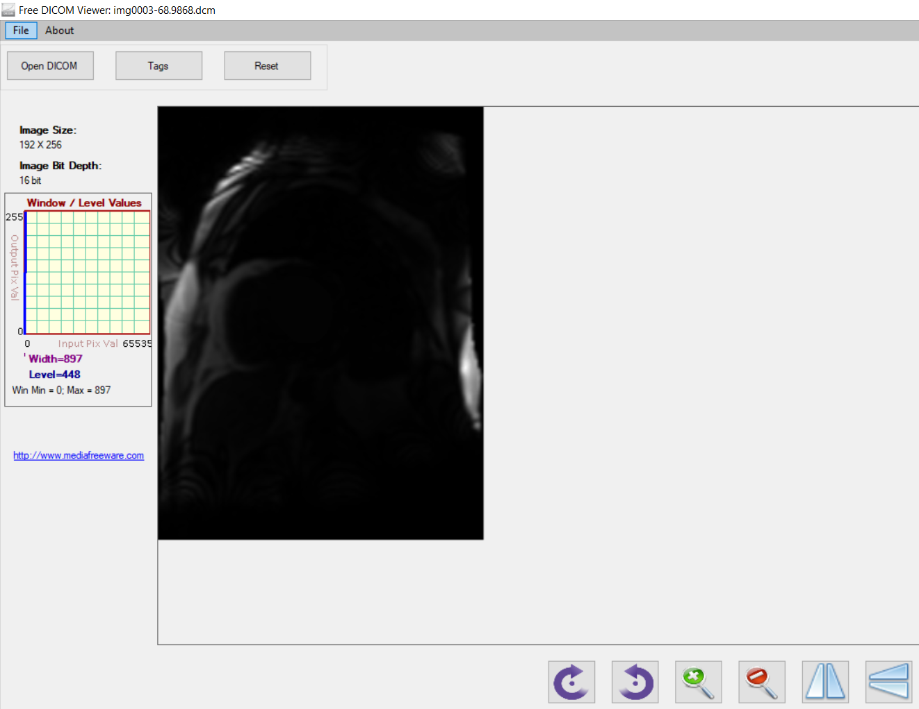
What is the content of the DICOM files

Slide 11
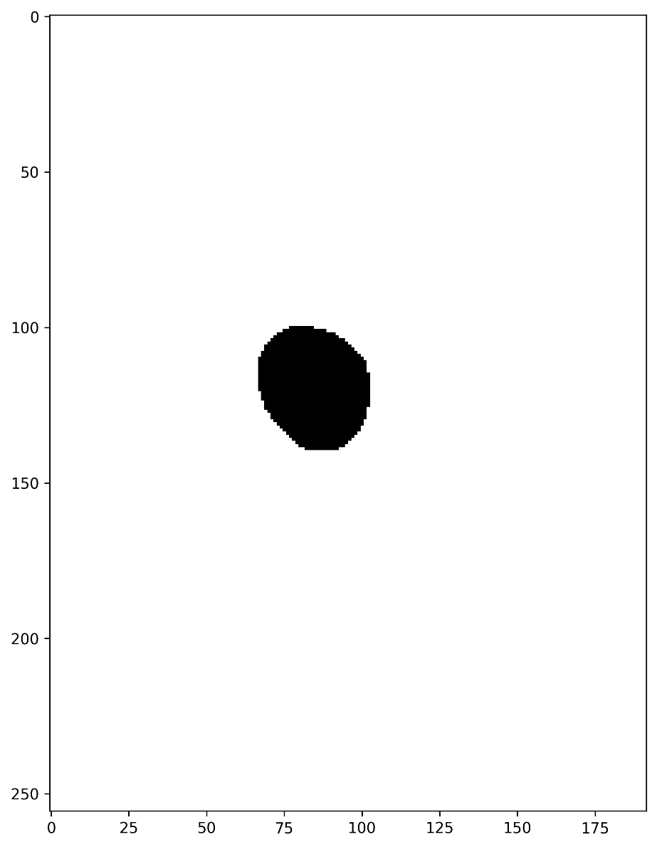
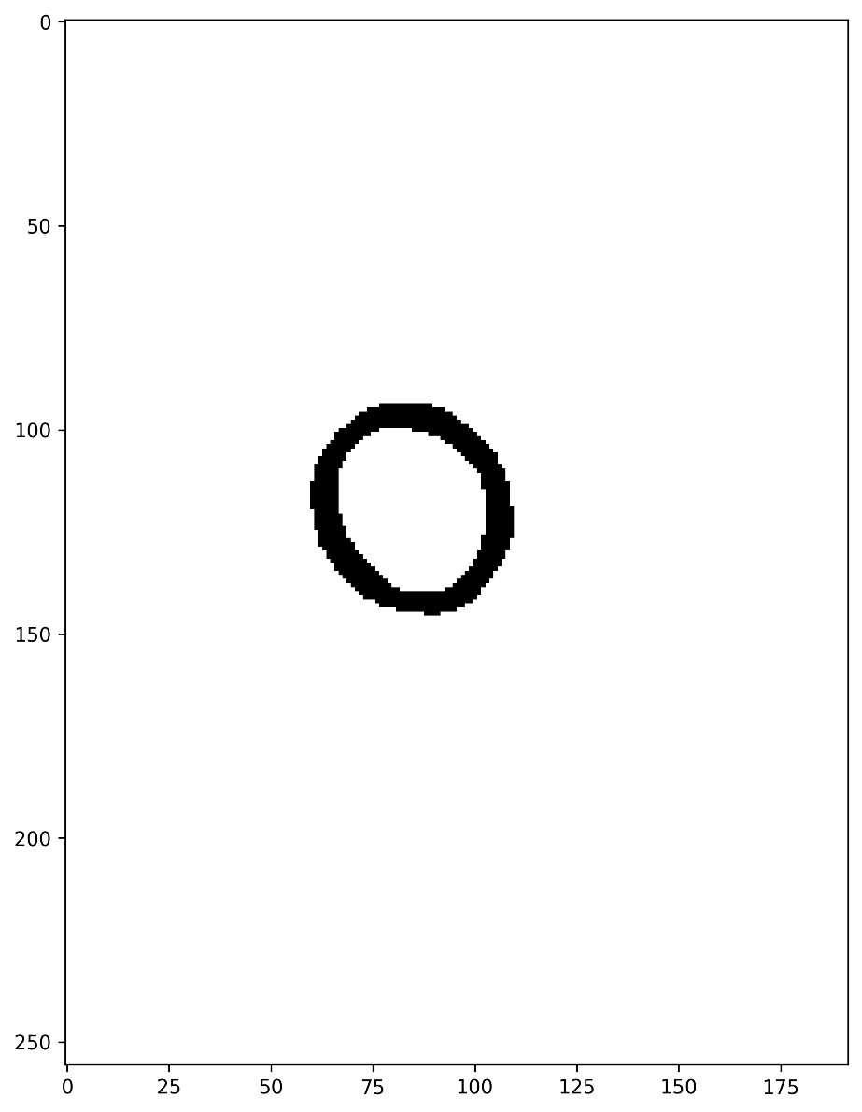
What is the two regions in the tiff file
The “AIF_And_Myo_Masks.tiff” file
Blood pool region are pixels that mask==0
Myocardium region are pixels that mask==1

Slide 12
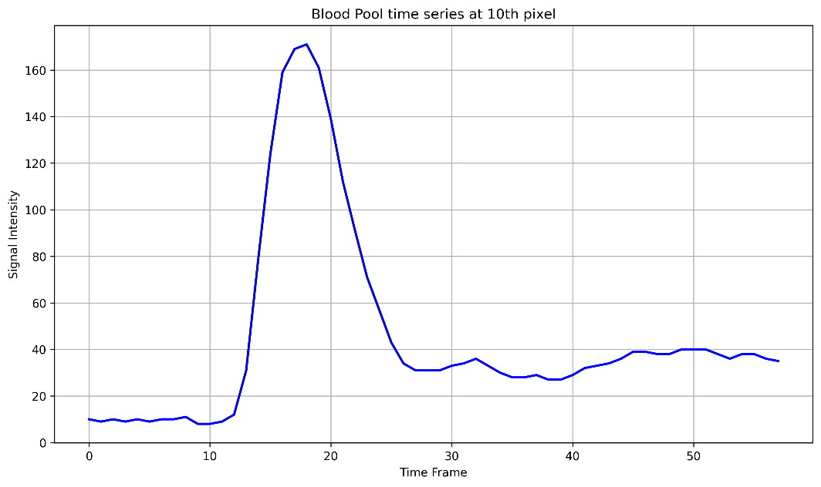
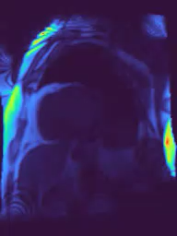
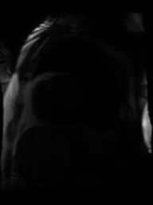
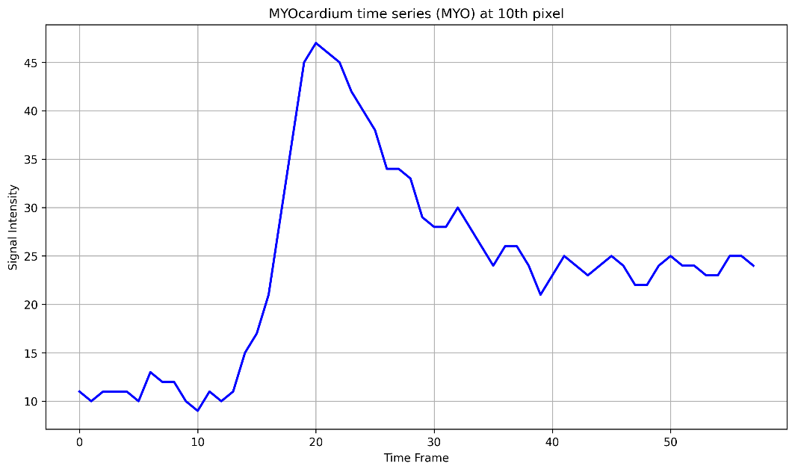
The content of the DICOM files over time
The signal intensity at a pixel of Blood flow region.
The signal intensity at a pixel of myocardium region.
Blood flow through the heart, animation.

Slide 13
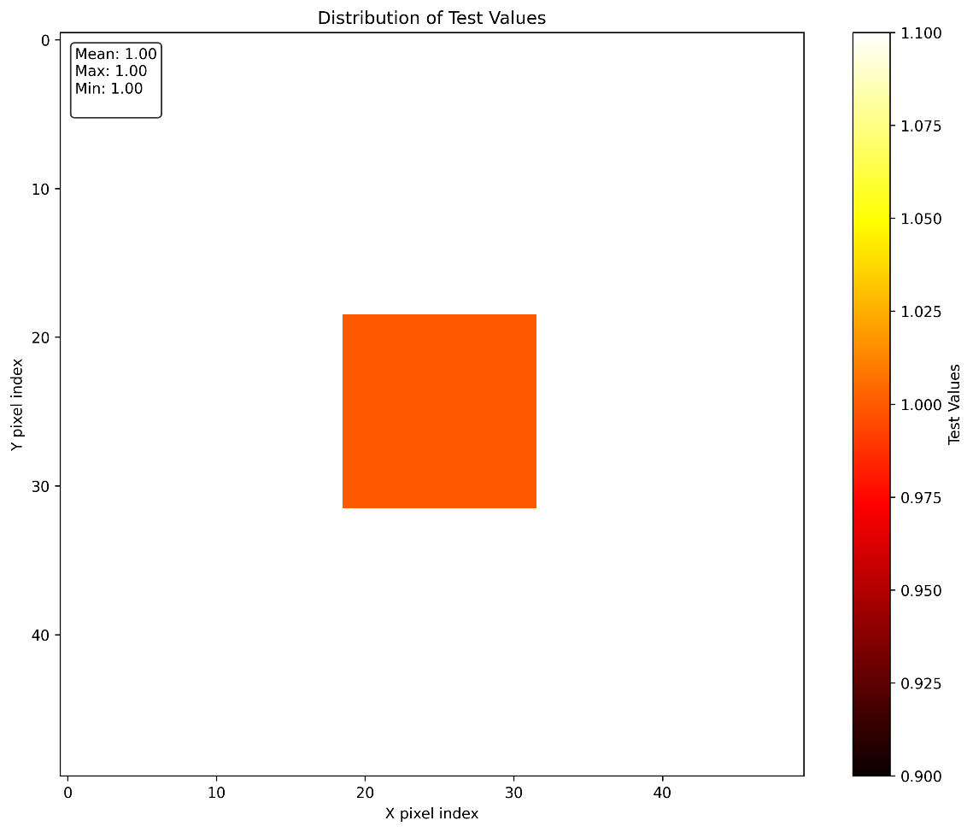
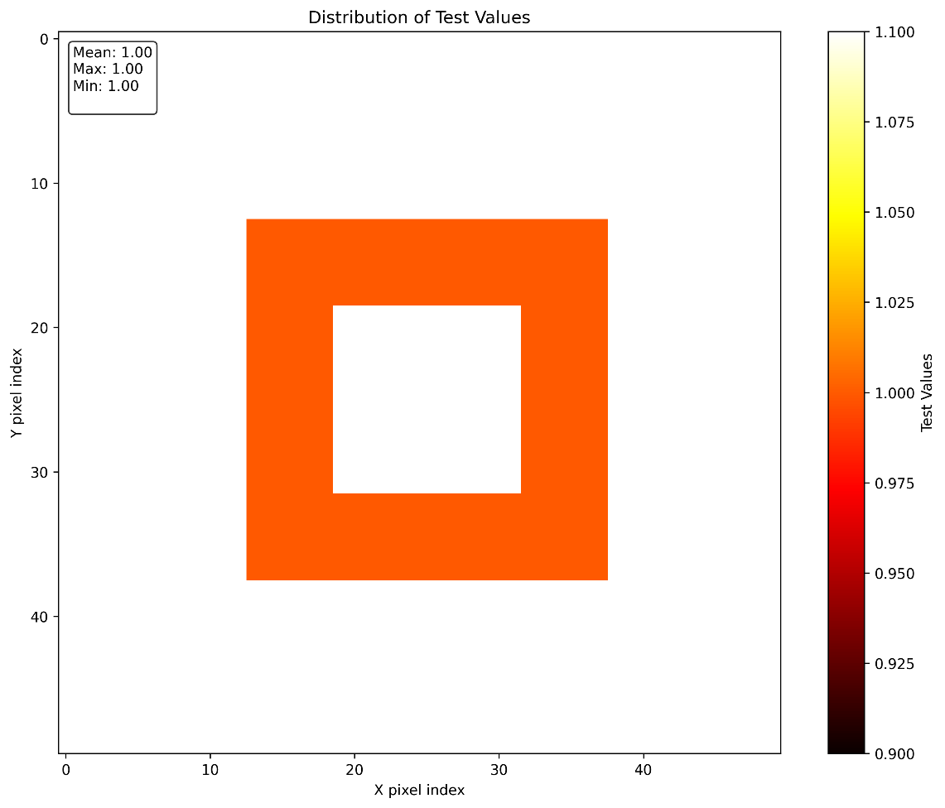
The content of the DICOM files over time

Slide 14
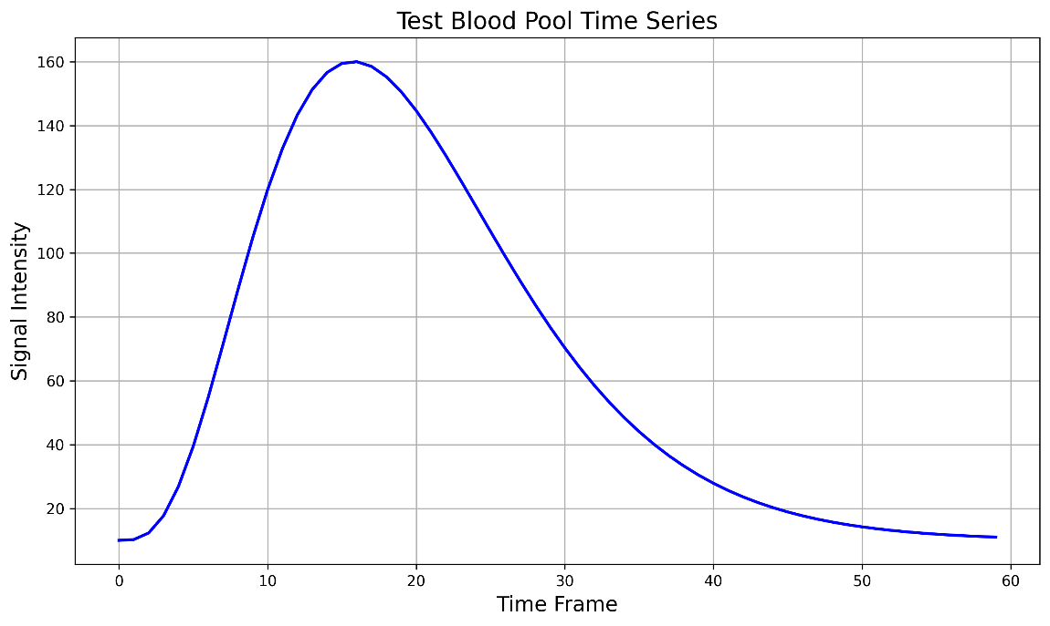
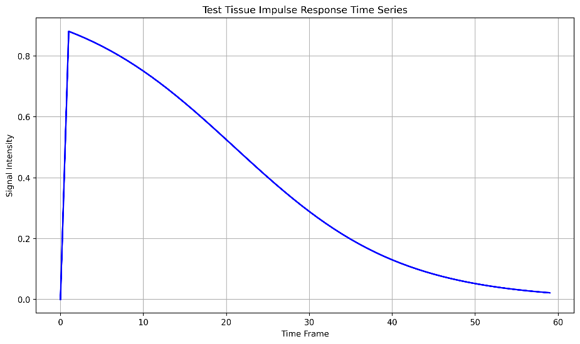
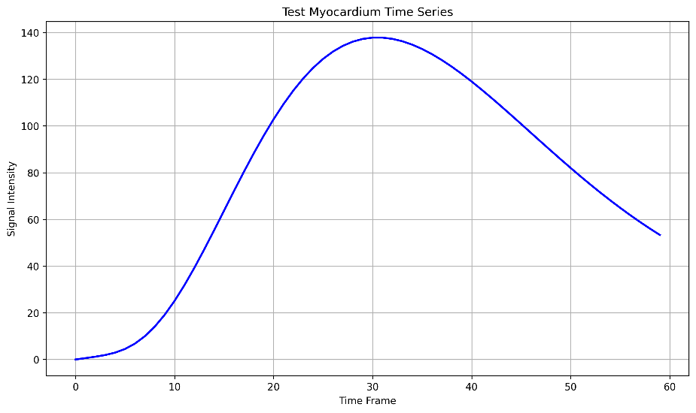
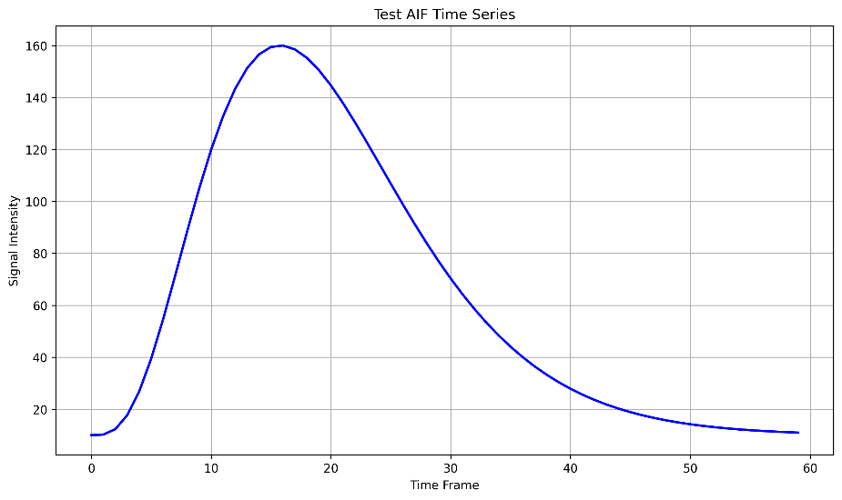
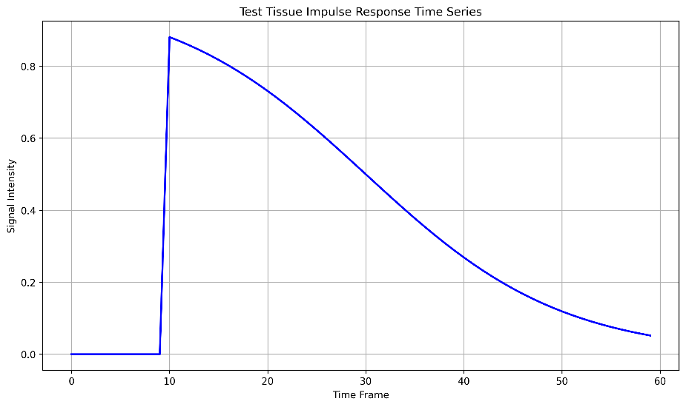
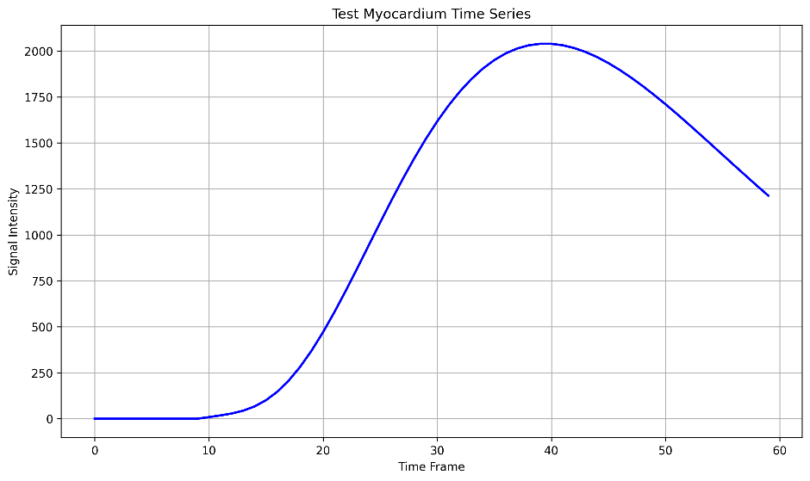
The content of the DICOM files over time

Slide 15
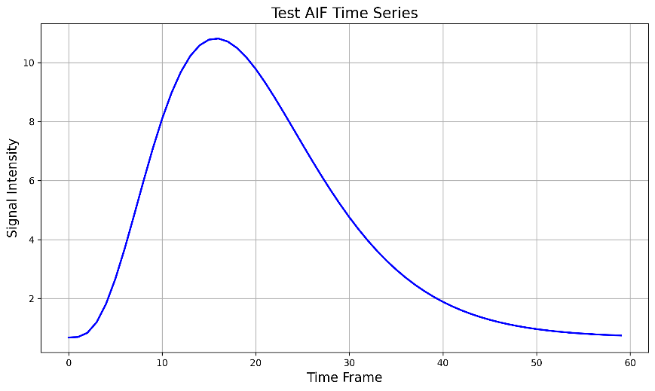
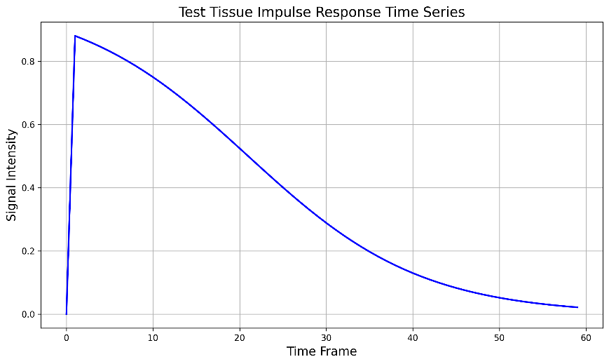
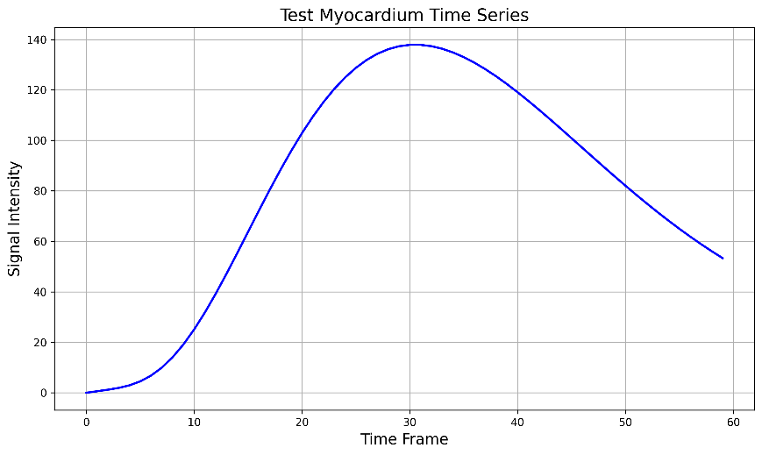
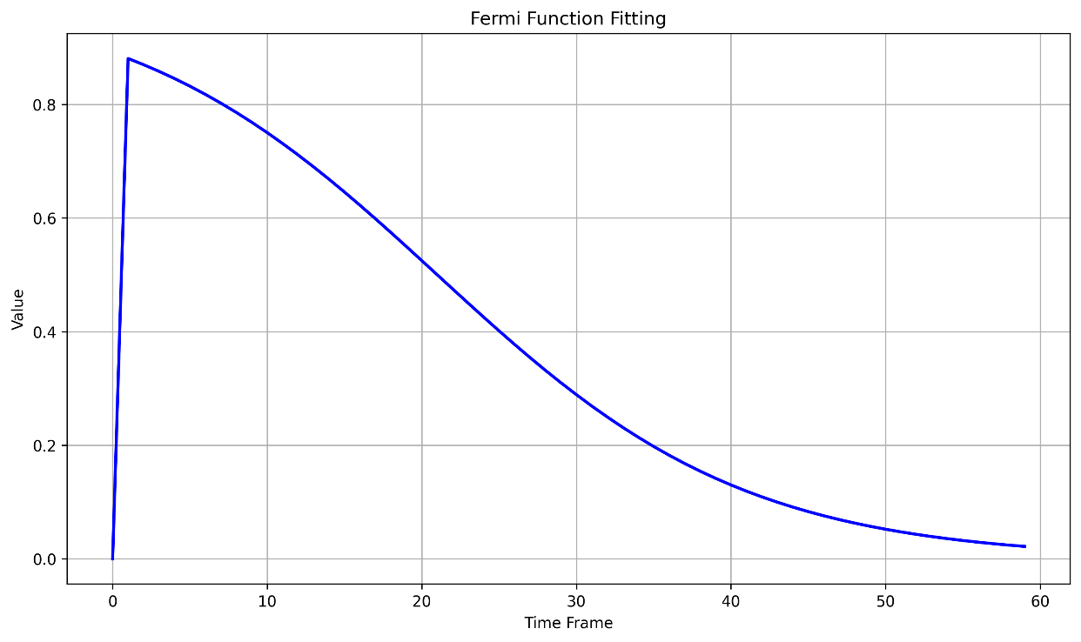
The content of the DICOM files over time
*
=

Slide 16
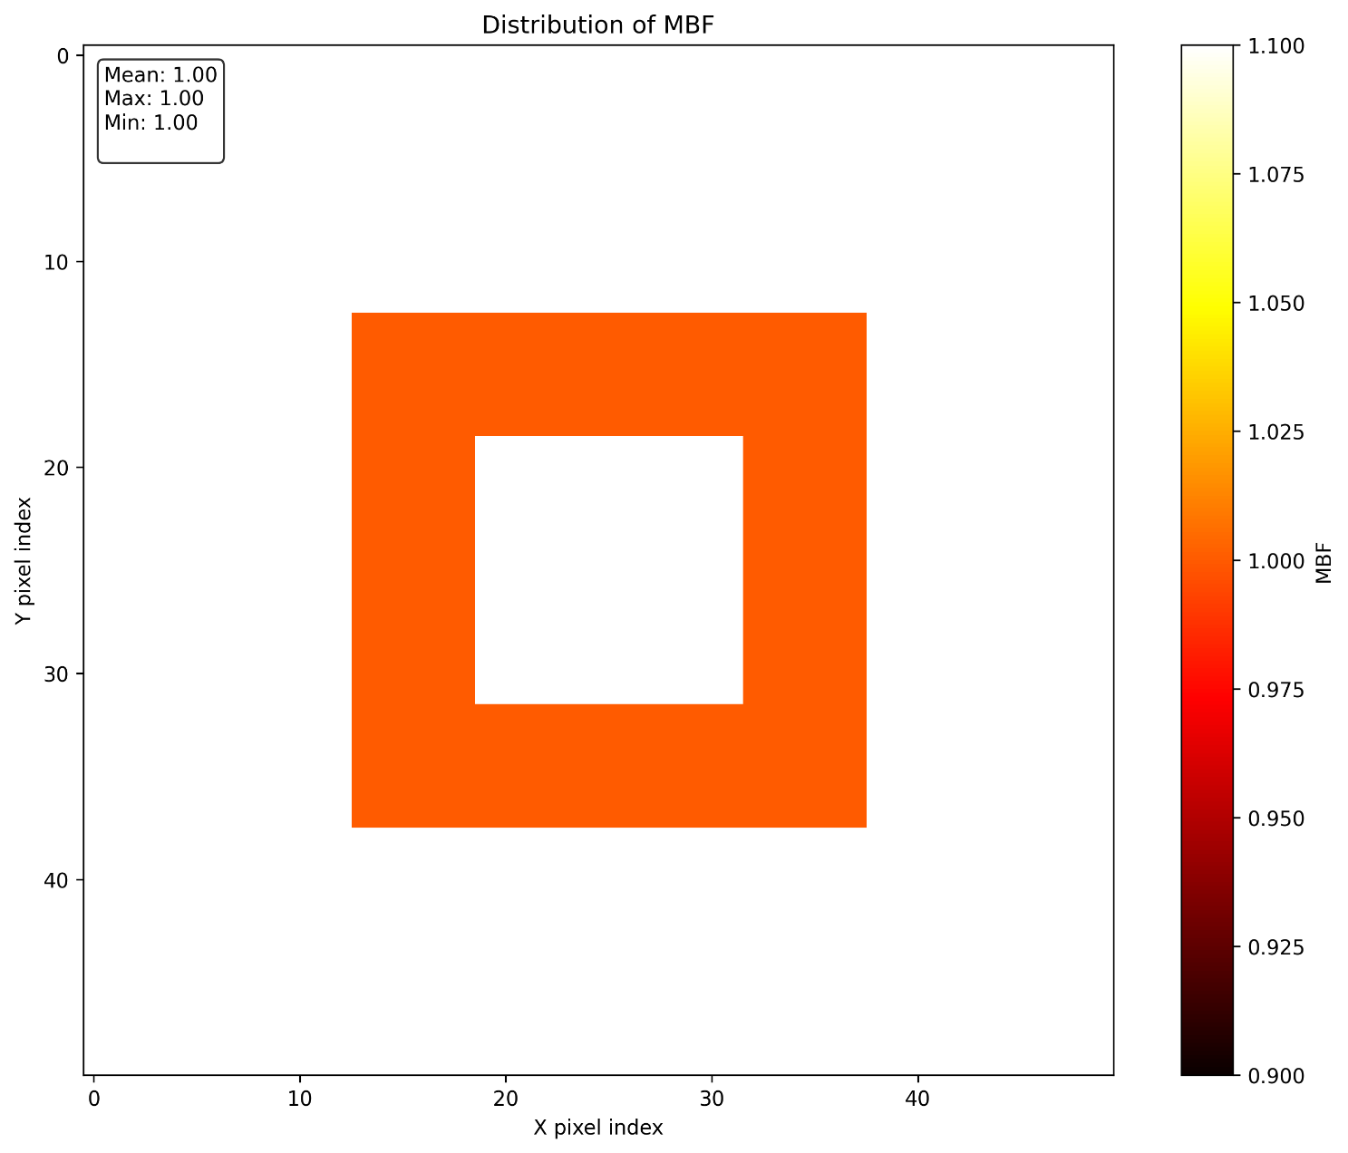
The content of the DICOM files over time

Slide 17
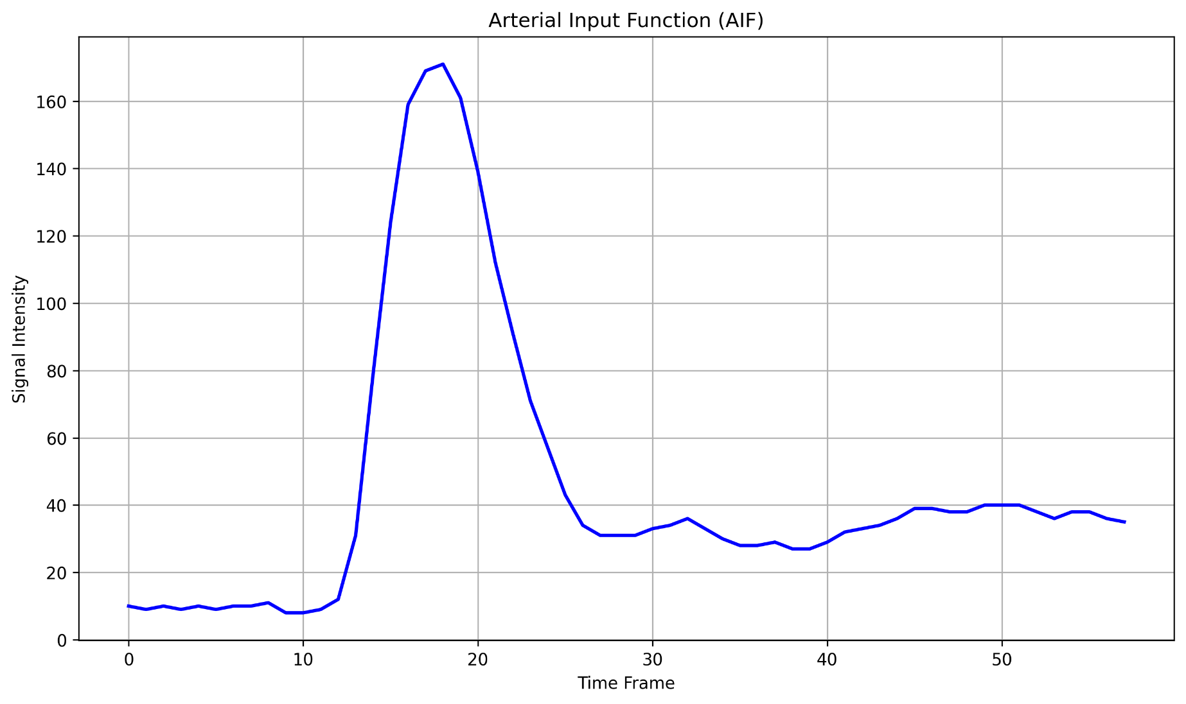
Arterial Input Function (AIF)
Performing an averaging on the blood pool region over time
It is done in compute_quantity.py in method arterial_input_function
Item 4 of section D of 1998 paper:
The signal time course in the LV blood pool can be used as an input function, cin(t), for deconvolution of the tissue curves, as previously validated in PET studies

Slide 18
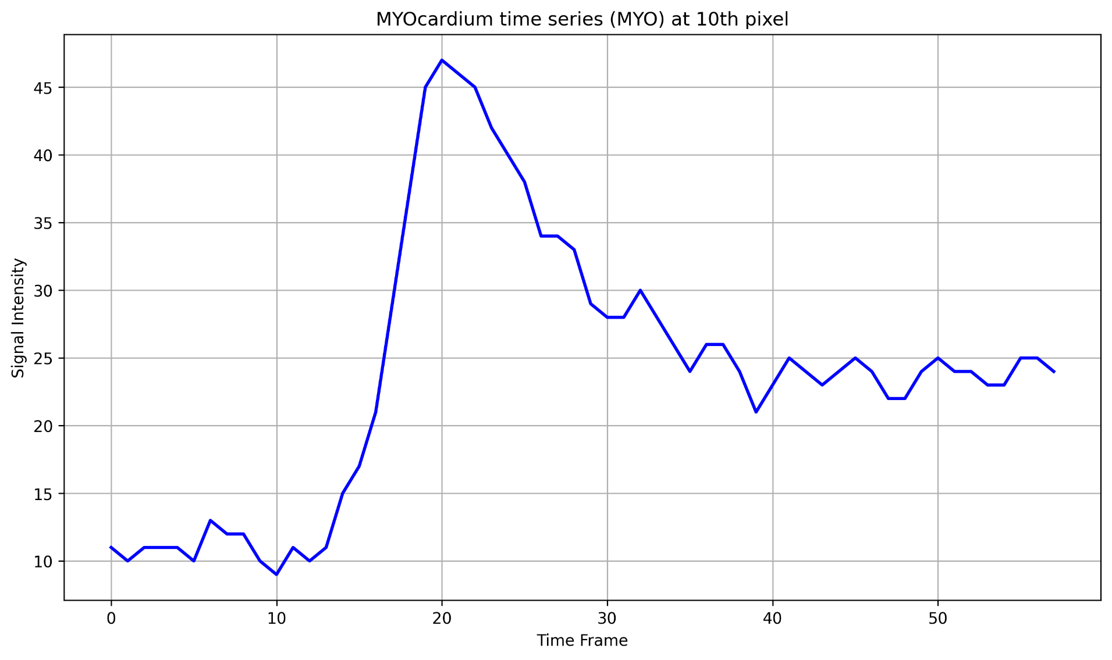
Signal intensity in myocardium region
MYO(t): Signal intensities for a pixel in the myocardium region for every pixel over time
It is done in compute_quantity.py in method myocardium_time_series

Slide 19
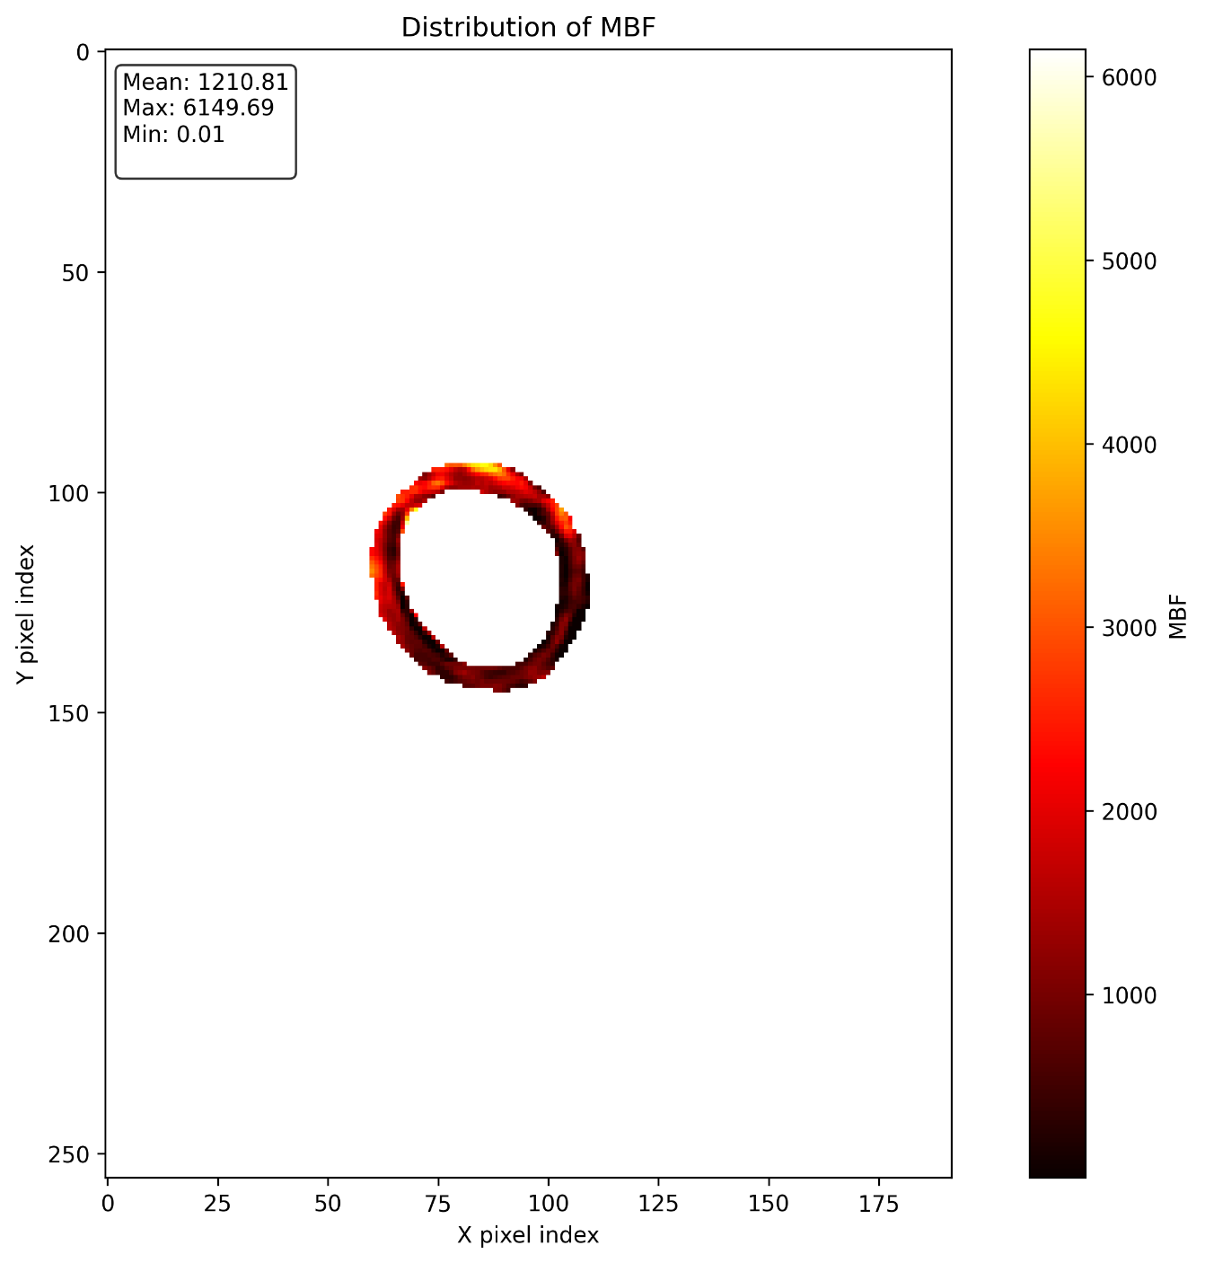
The Pathway of Blood Flow Through the Heart, Animation.

Slide 20
The Pathway of Blood Flow Through the Heart, Animation.

Slide 21
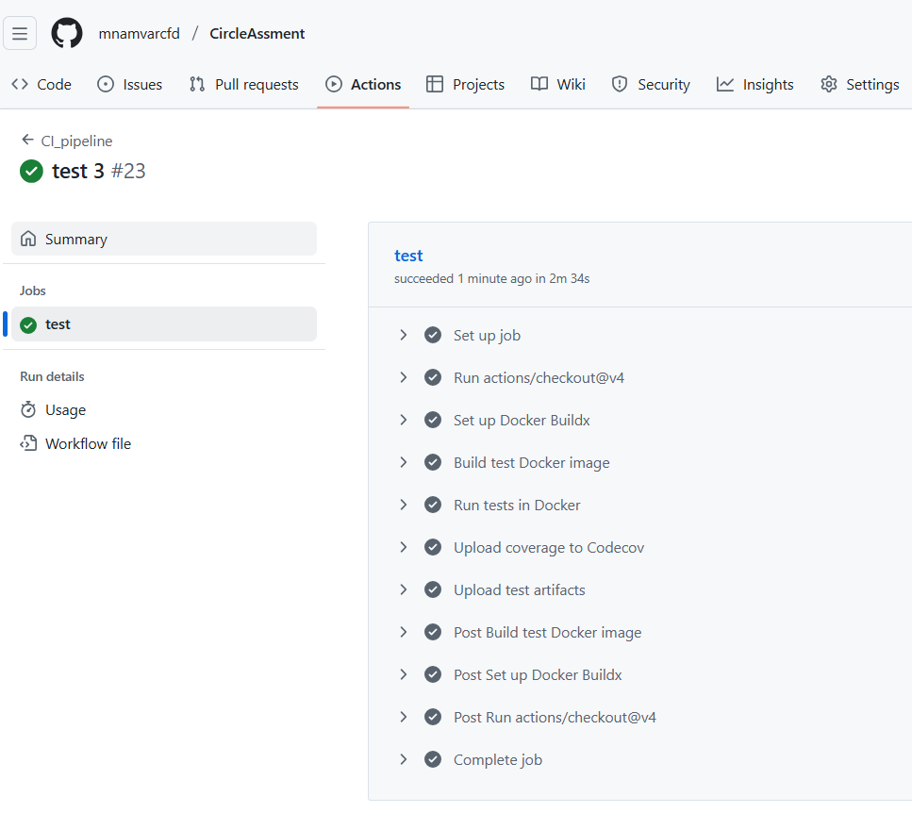
The Pathway of Blood Flow Through the Heart, Animation.

Slide 22
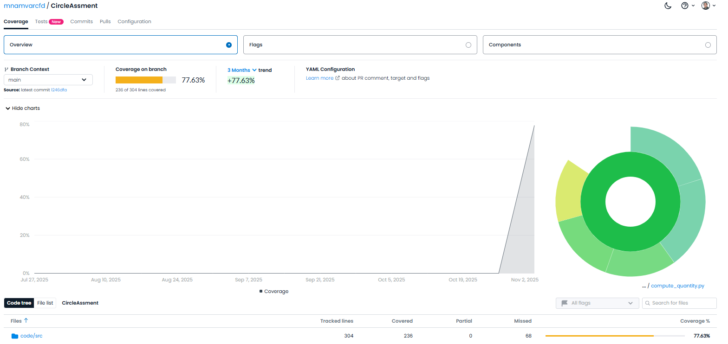
Development of the code

Slide 23
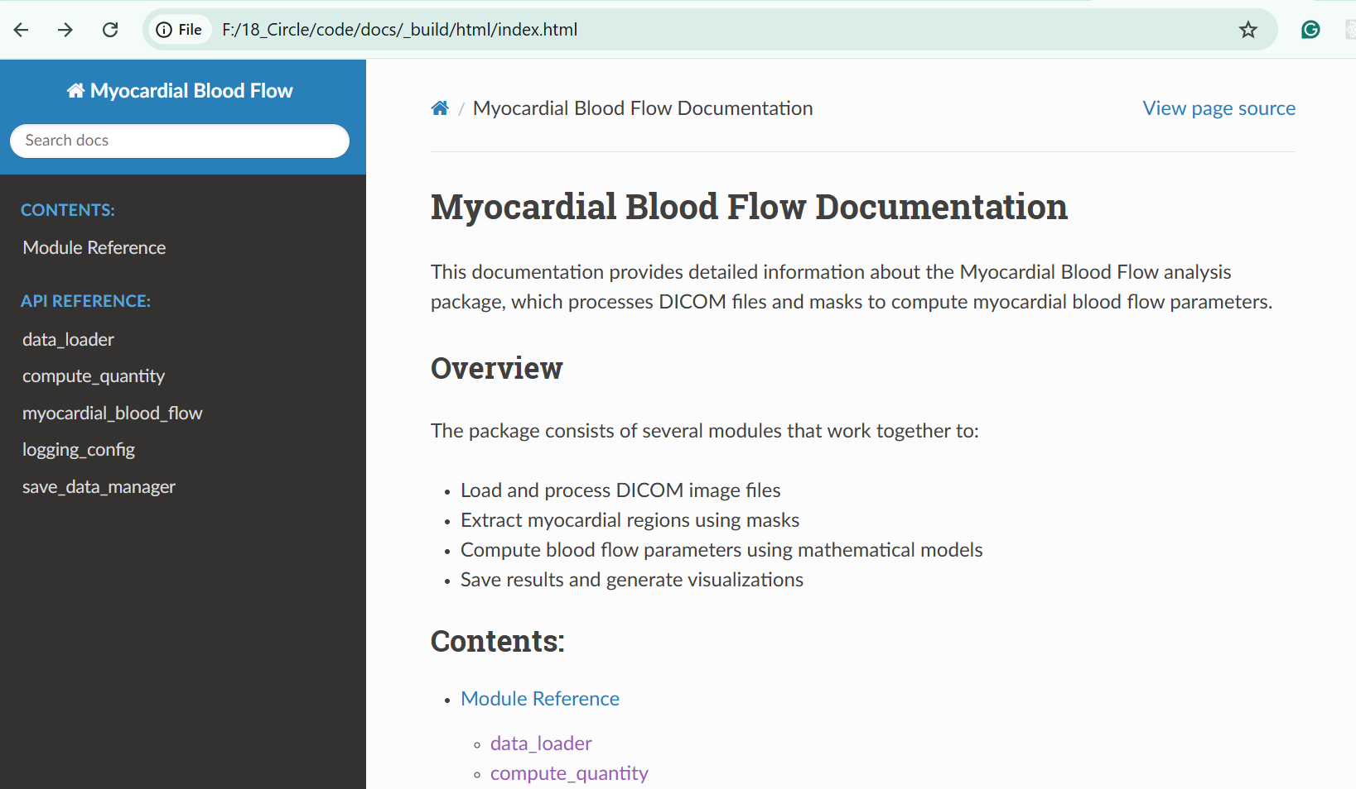
The Pathway of Blood Flow Through the Heart, Animation.

Slide 24
The Pathway of Blood Flow Through the Heart, Animation.

Slide 25
The Pathway of Blood Flow Through the Heart, Animation.

Slide 26
The Pathway of Blood Flow Through the Heart, Animation.

Slide 27
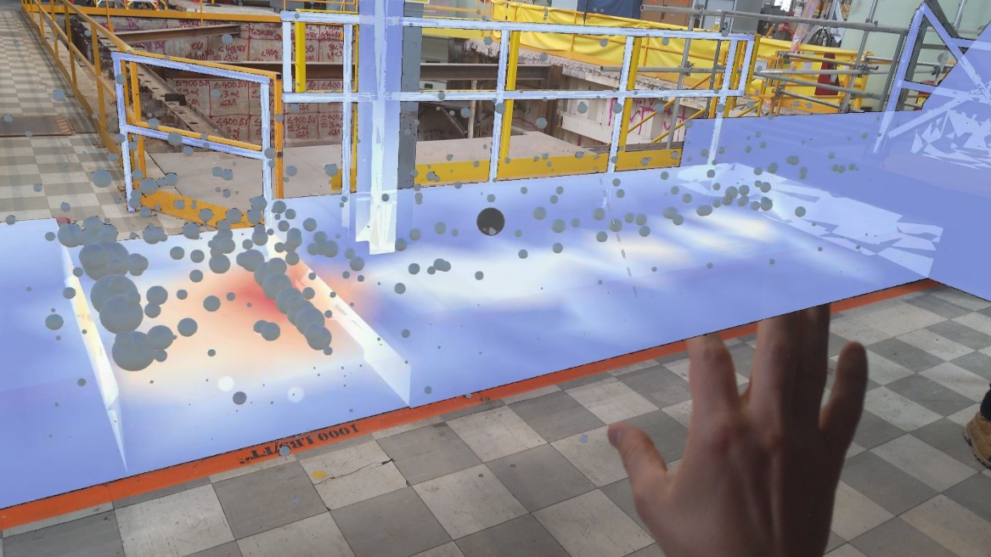
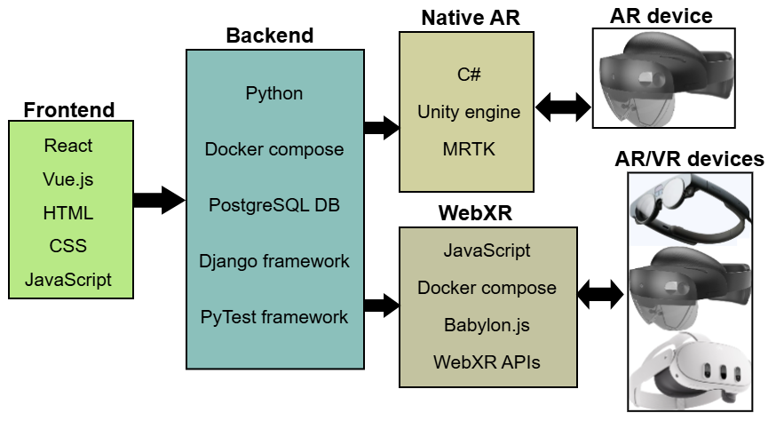
Second Postdoc: 2023-Present
Radiation field visualization in nuclear facilities using AR and VR technologies

Slide 28
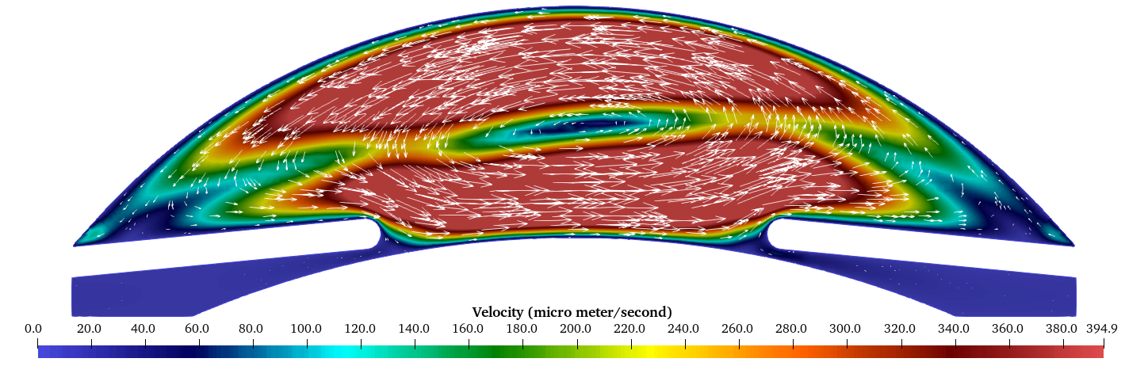
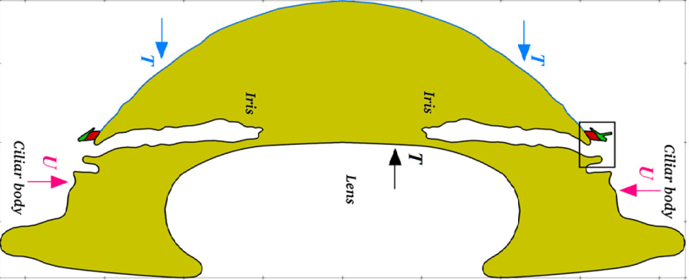
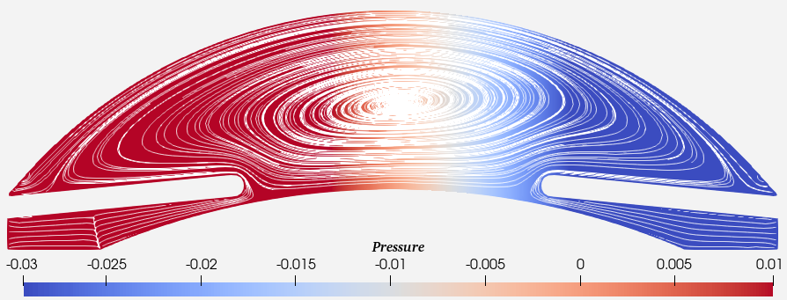
First Postdoc: 2022-2023
Modeling tritium movement through human eye lens in computational framework.

Slide 29
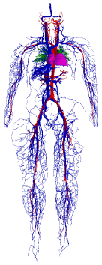
Ph.D. project
An algorithm for the lattice Boltzmann method adapted to sparse geometries and distributed memory systems
Fluid flow simulation software
Developed C++ code
Worked on super computers
Modified an algorithm
Developed 2 algorithms along with implementation in C++
To simulate the full human vessels, around 1.6 billion nodes are required

Slide 30
Working period in Iran
C++/Python
Scientific computation software
Fluid flow simulation software
Geometry optimization
Parallel programming using MPI, OpenMP, CUDA
About 100,000 lines

Slide 31
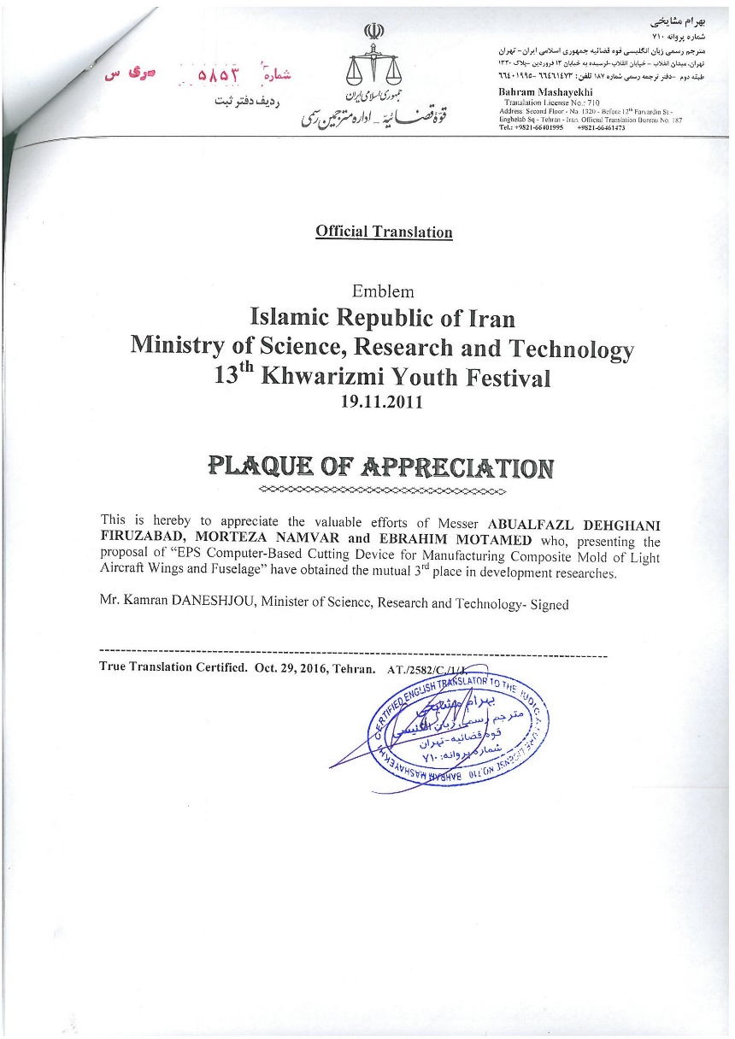
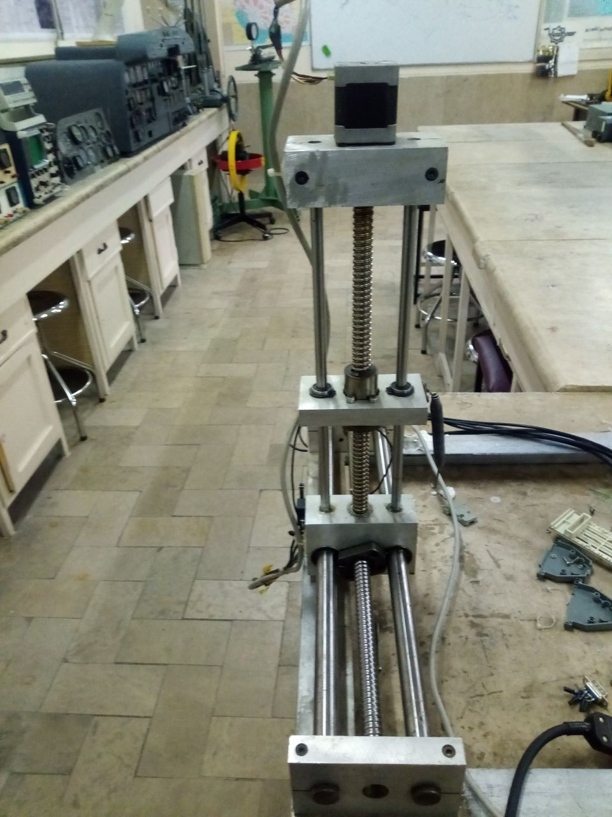
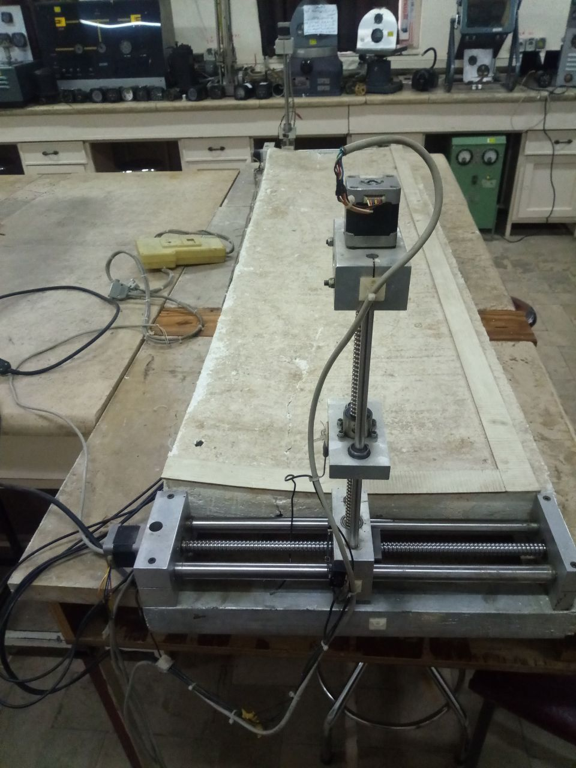
My invention:

Slide 32
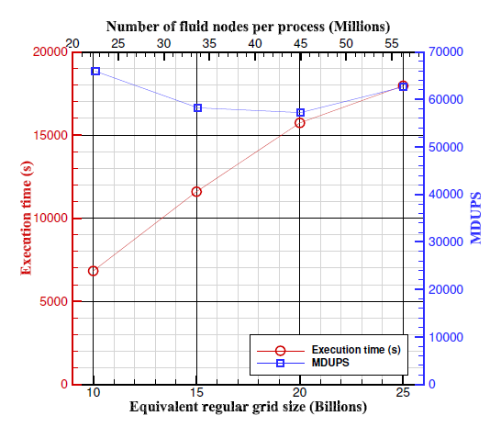
The biggest problem I solved by the developed code:

